Slide 1
Radiogenomic Analysis of Glioblastoma with Deep Learning Techniques
06/05/2022
Final Representation
Yichong Wang
wangyichong@u.nus.edu

Slide 2
Brief Introduction

Slide 3
Glioblastoma
Glioblastoma (GBM) is a highly aggressive adult brain tumor and the deadliest brain tumor that originates in glial cells.
A high degree of heterogeneity in both space and time
Do not respond well to prescribed therapy because therapy targets the entire tumor rather than specific genetic sub-regions.
Three main criteria to divide GBM subtypes
The most common subtype we use in lab is Varhaak et al. research in 2010

Slide 4
Radiogenomics
Image acquisition;
Image processing, including noise/artifact reduction, intensity and/or orientation standardization, coregistration of the multiparametric MRI scans
ROI definition using manual annotation or automatic segmentation
Feature extraction based on human-engineered (conventional radiomics) or deep-learning approaches
Data analysis, involving machine/deep-learning methods for feature selection, classification, and cross-validation

Slide 5
Segmentation

Slide 6
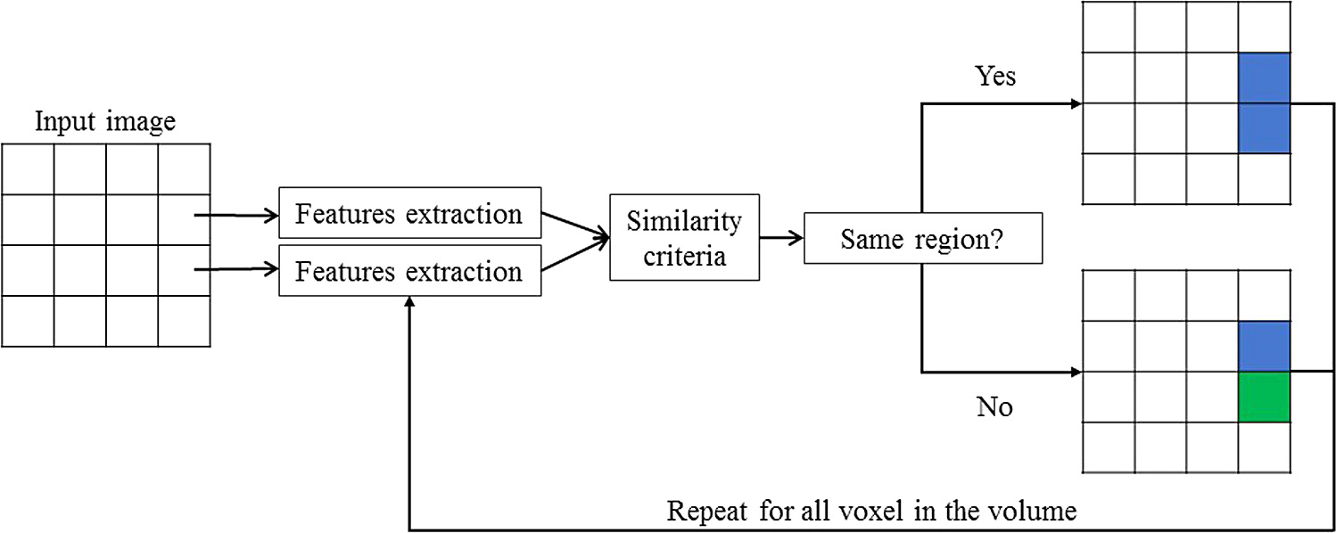
Segmentation Approaches
Region-based Approaches
Classification approaches
Edge-Based Approaches
Altas-based approcahes

Slide 7
Data
Public dataset – Ivy Gap
This data collection consists of MRI/CT scan data for brain tumor patients that form the cohort for the resource Ivy Glioblastoma Atlas Project (Ivy GAP).
There are 390 studies for 39 patients that include pre-surgery, post-surgery and follow up scans.
Manual annotation, transform to MNI space
We use slice in Z axis, from 30 – 150 slice to avoid boundary of brain

Slide 8
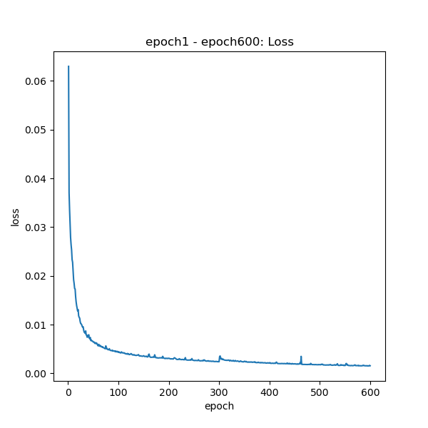


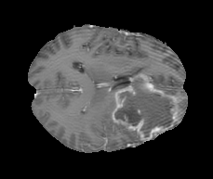
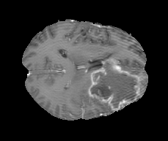
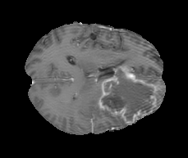
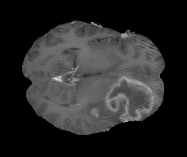
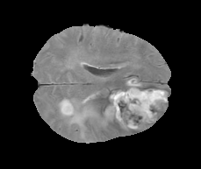
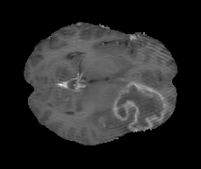

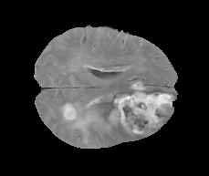
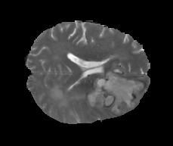
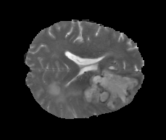

Architecture
Plot graphs and write logs
Train Part
train
data.py
train.py
trainHelper.py
T1
80%
Replace Maxpooling layer with stride = 2, kernel = 3 ‘s convolutional layer
Add batch normalization layer and dropout layer
W1-W55 Patients, with T1, T2, FLAIR
Choose one
Shuffle
Every epochs save a model
dataset
… …
20%
FLAIR
U-net Model
Validation Part
Validation Results
Patient ID < W5
Last Model
Train Set
Test Set
U-net Model
T2
Assessment

Slide 9
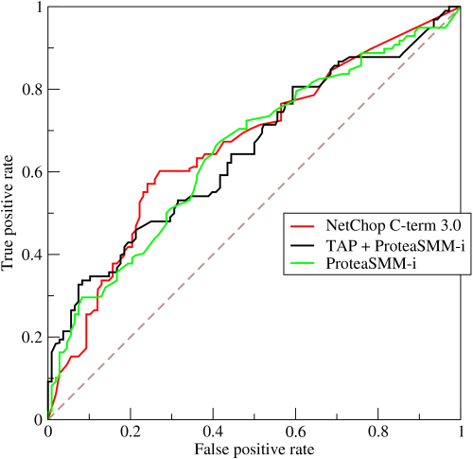
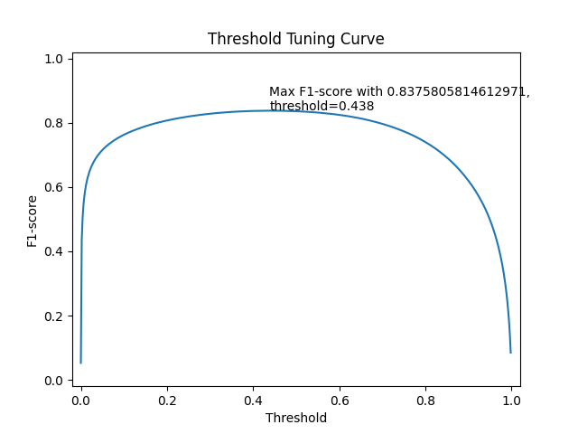
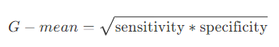
Threshold – ROC & Threshold Tuning Curve
In my segmentation Part, I use 0.5 as threshold. Though the architecture last layer is sigmoid, the 0.5 is not the best threshold to do segmentation. We can use ROC or Threshold Tuning Cruve to distinguish the best threshold
ROC (Receiver operating characteristic), is a graphical plot that illustrates the diagnostic ability of a binary classifier system as its discrimination threshold is varied. It is created by plotting the true positive rate (TPR) against the false positive rate (FPR) at various threshold settings.
ROC has two usages：
Compare different method in binary classification.
Find best threshold for binary classification using G-mean
Threshold Tuning Curve with x axis is Threshold, y axis is F1-score, the goal of Threshold tuning curve is to find the bese F1-score corresponding threshold

Slide 10
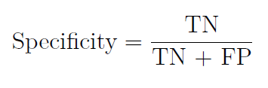
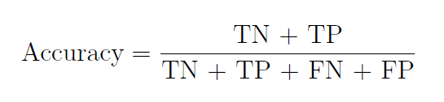
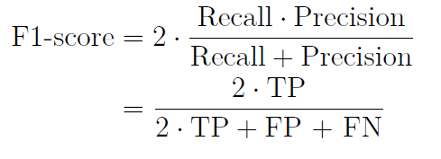
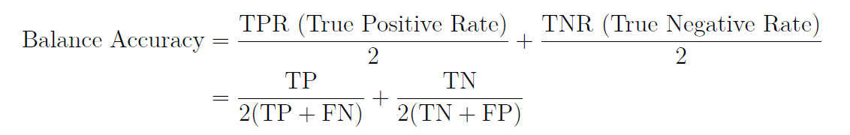
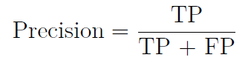
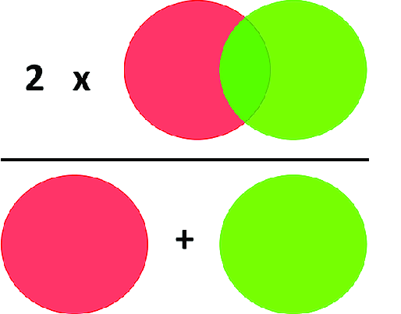
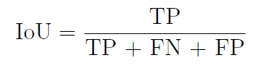
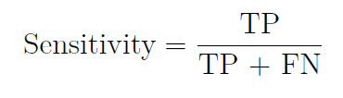
Segmentation Assessment

Slide 11
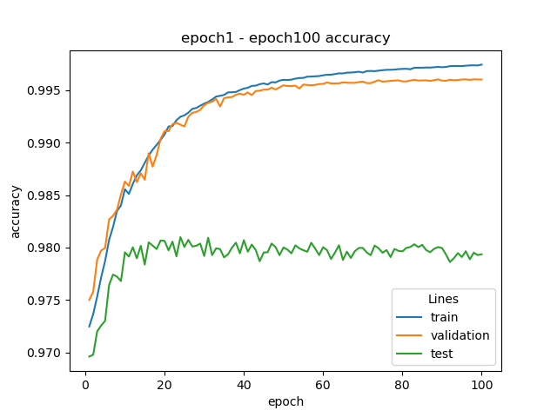
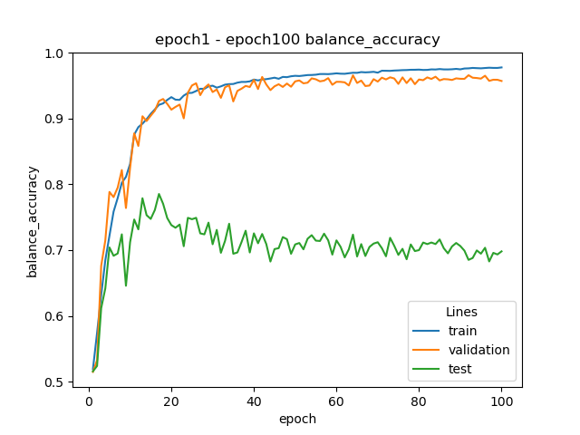
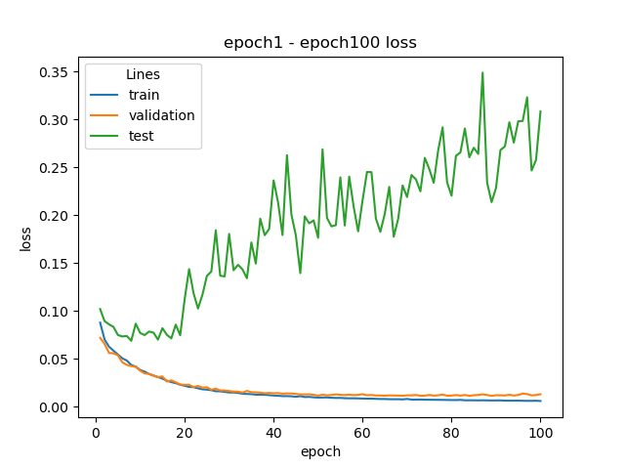
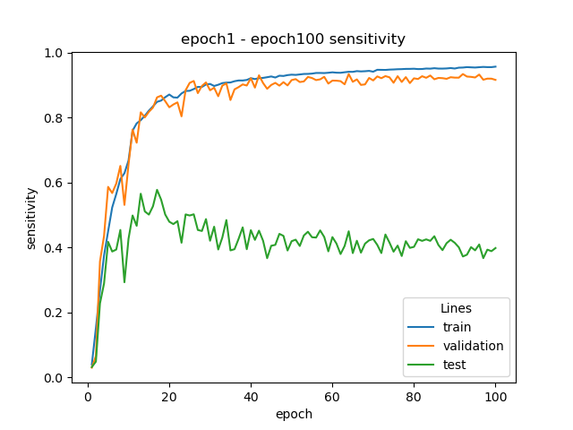
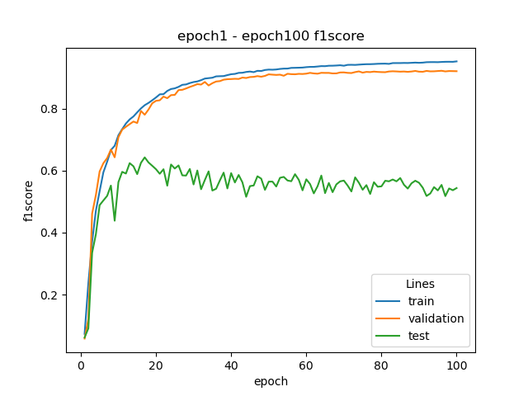
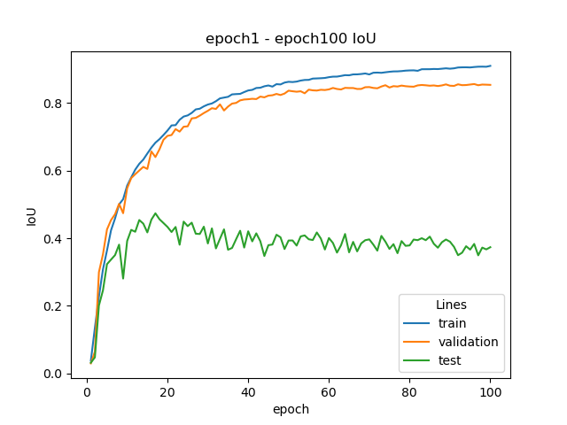
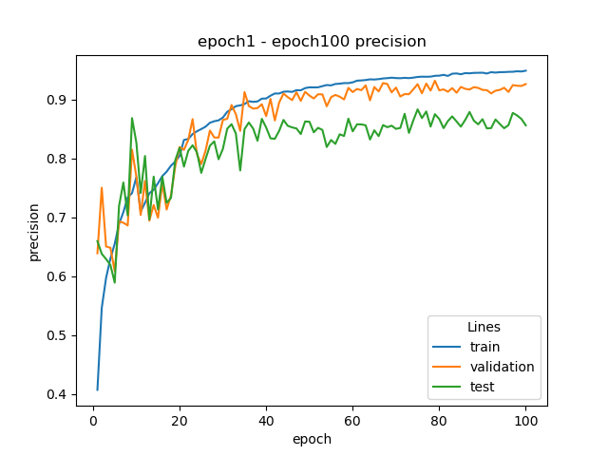
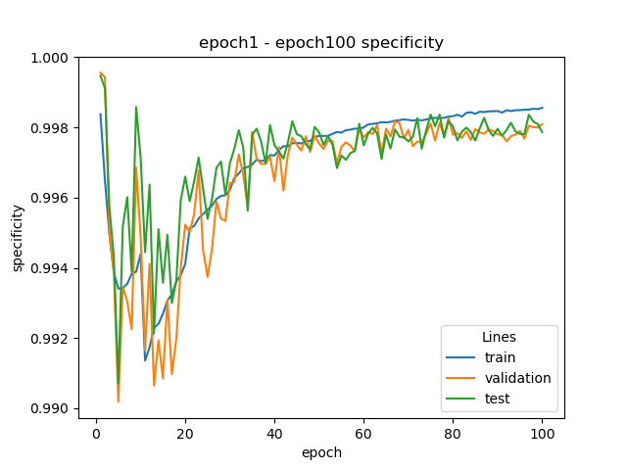
Segmentation Result T1

Slide 12
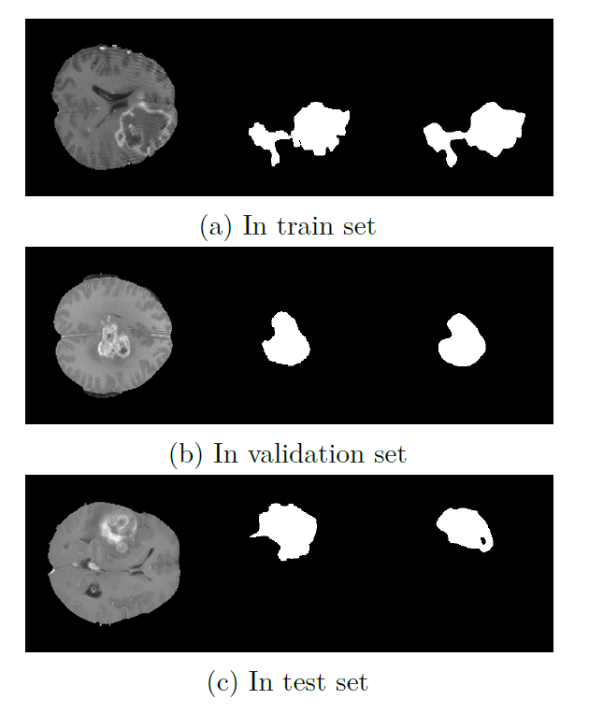
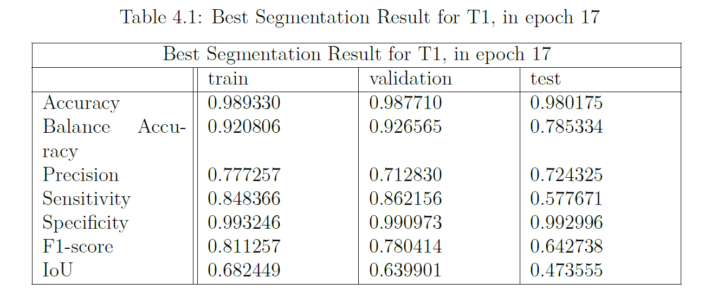
Segmentation Result T1
For some patient, the T1’s result is also good, but for some patient’s T1 series MRI image cannot distinguish the GBM tumor area, based on the Ivy Gap dataset
Left is original image, middle is ground truth, right is prediction

Slide 13
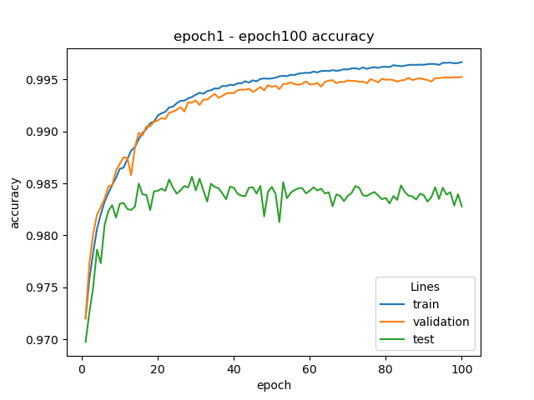
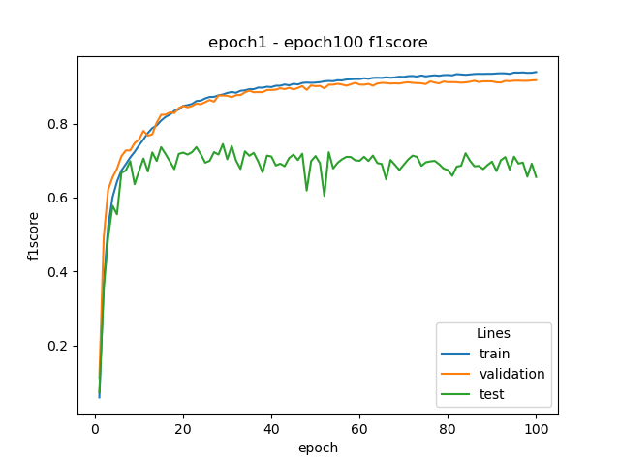
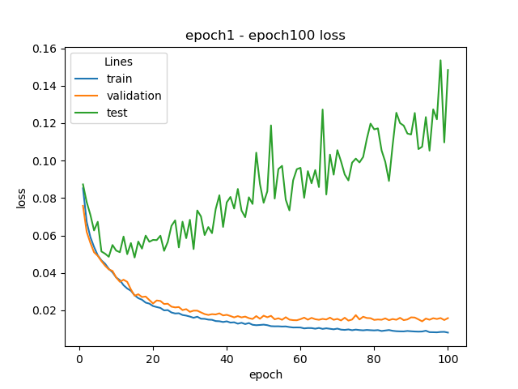
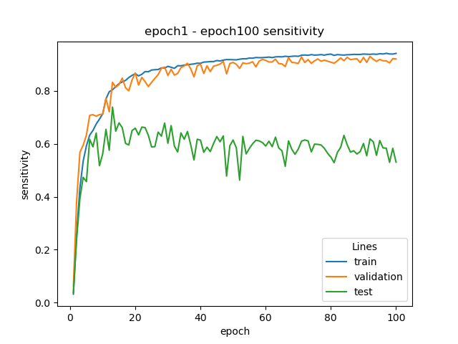
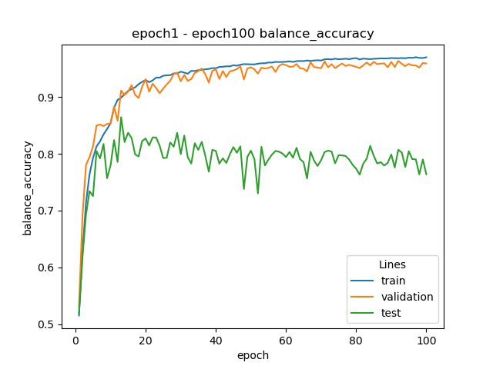
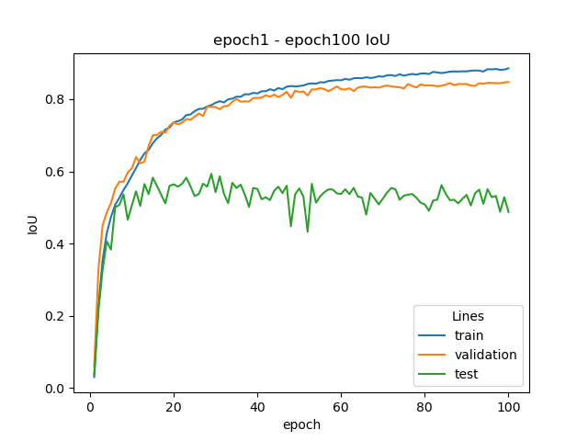
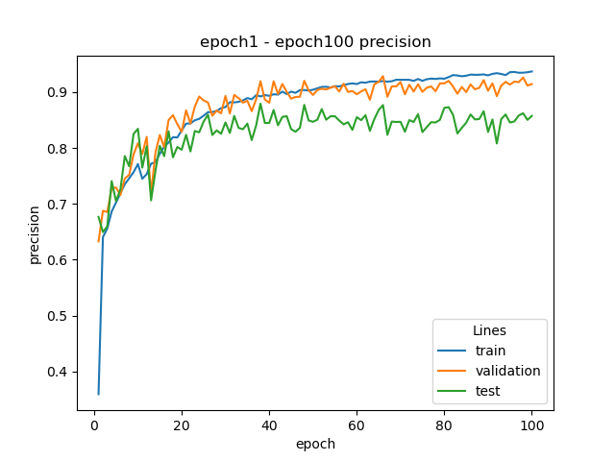
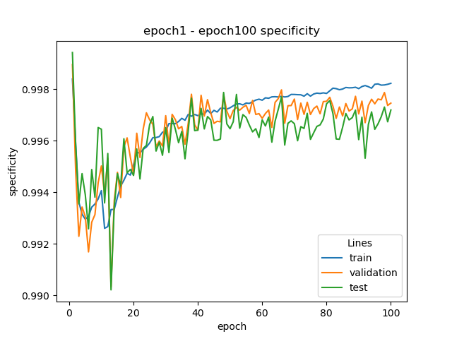
Segmentation Result T2

Slide 14
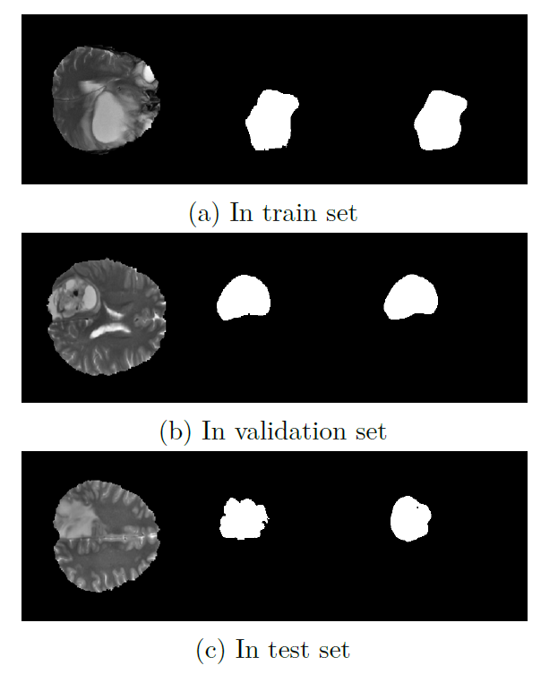
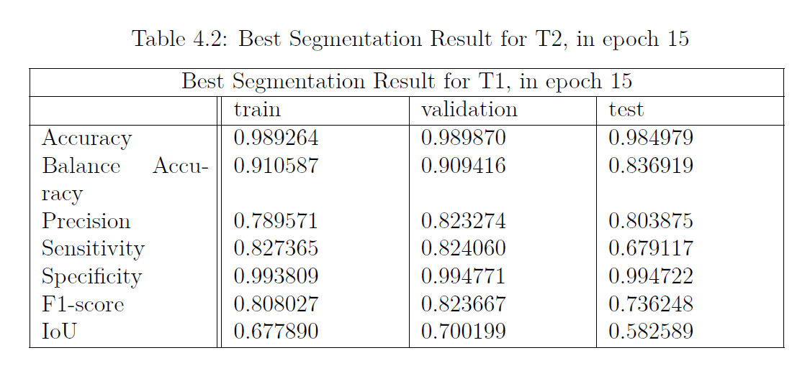
Segmentation Result T2
T2 have the same situation like T1
Left is original image, middle is ground truth, right is prediction

Slide 15
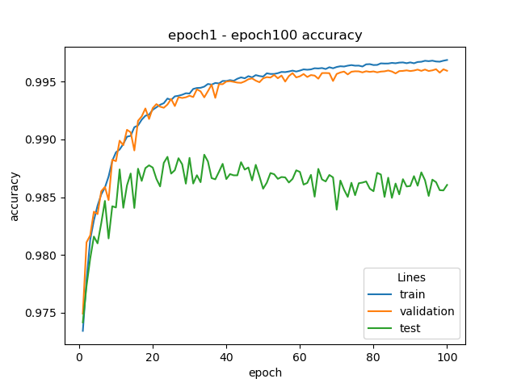
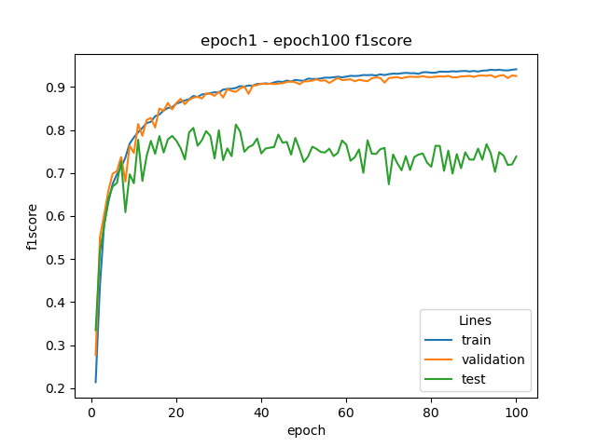
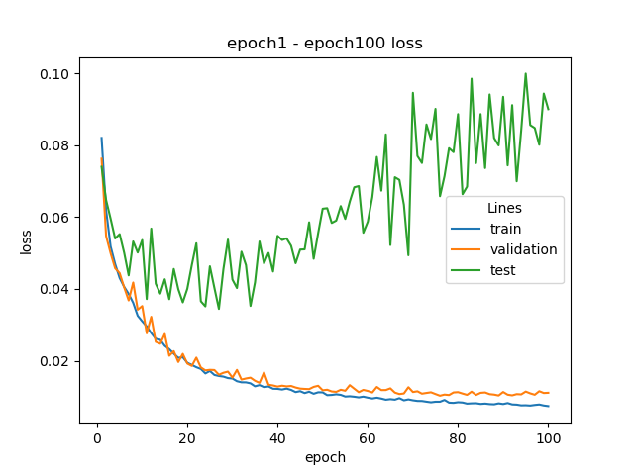
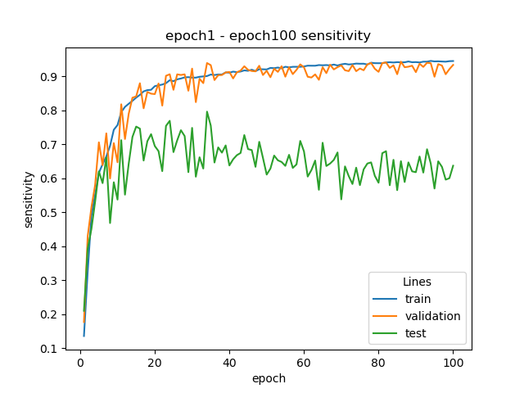
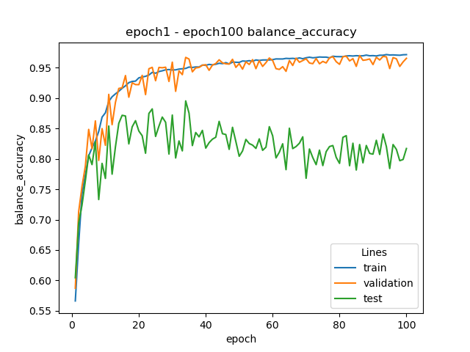
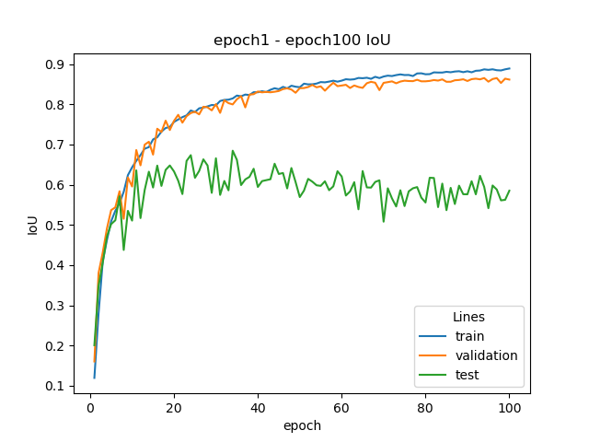
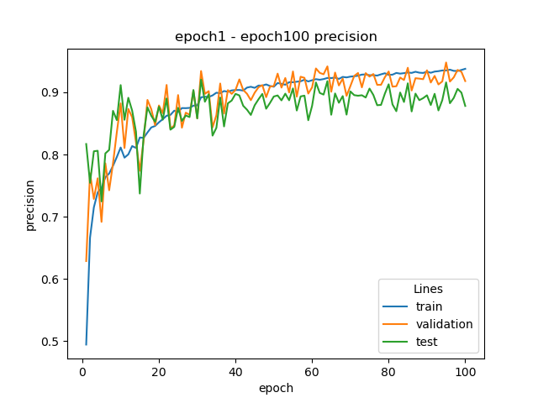
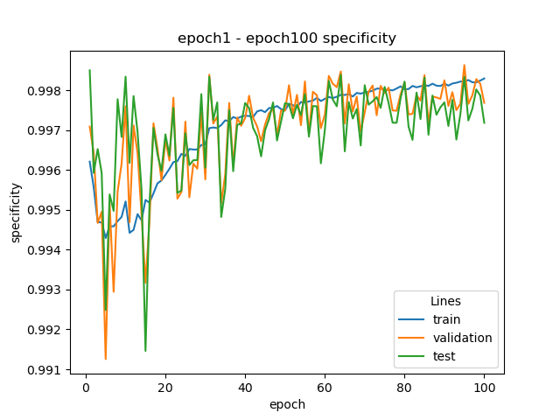
Segmentation Result FLAIR

Slide 16


Segmentation Result FLAIR
FLAIR situation is much better
Left is original image, middle is ground truth, right is prediction

Slide 17








Segmentation Result Stack

Slide 18


Segmentation Result Stack
Stack is the best
Left is original image, middle is ground truth, right is prediction

Slide 19
Feature Extraction

Slide 20
Feature Extraction
In the feature Extraction procedure, we apply conventional CV method, using specific equation to calculate features to put image information from 2D to 1D
At first, I use my own code to calculate features, but the speed is slow. Right now, we use pyradiomics module to extract features from ROI
Pyradiomics have 120 features, most of them are texture features.
The most classical texture feature design is using GLCM

Slide 21
Subtype classification

Slide 22

Classify GBM Subtypes
Overview:
Decision Tree: 56%
Random Forest: 77%
MLP: 80%
Linear SVM: 40%
MLP have the best preference in classifying this dataset
This dataset is not linear relationship

Slide 23

Classify GBM Subtypes
Decision Tree: 68%
Random Forest: 84%
MLP: 88%
Linear SVM: 54%
Because one GBM cancer in one patient have different subtypes in different subregions, using two subtypes combined into a tuple as a label is very not scientific

Slide 24
Classify GBM Subtypes
Decision Tree: 68%
Random Forest: 84%
MLP: 88%
Linear SVM: 54%
Because one GBM cancer in one patient have different subtypes in different subregions, using two subtypes combined into a tuple as a label is very not scientific

Slide 25


Classify GBM Subtypes
According to Wang's research in 2017, Neural cannot be counted as a molecular subtype alone, and can be combined with Proneural to be regarded as the same type
Random Forest: 87%
MLP: 92%

Slide 26
Mutual Information

Slide 27

Mutual Information
Through mutual information analysis, we can see that image features are closely related to genes CD44, TGFBR2, IGFBP2, and MECOM, both in the core area of the tumor and in the infiltrated area. Other gene expression is almost irrelevant. Perhaps this conclusion can reveal more key genes for transcription-based molecular subtype classification. At present, strong evidence cannot be drawn only through the mutual information analysis of radiomic characteristics and gene strength, and it needs to be combined at the biological level to explore.

Slide 28
GUI

Slide 29

GUI

Slide 30
Conclusion, Significance & Outlook

Slide 31
Conclusion, Significance & Outlook
Conclusion:
For segmentation, we can draw a conclusion that the U-Net model can perform the “half-auto” segmentation very well. It means doctor need to do some manual annotation for some slice and then the model can perform very well on this patient. This because the data we train the model is too little, it can not know all patients tumor feature and the GBM has a very high degree of heterogeneity in both space and time.
We can use MLP to classify the GBM subtype by the classical radiomic feature vector. It’s all about math, but can not be explained in bio-level, which is the common subject of radiomics.
Significance:
Noninvasive
Fast with low cost
Detect trend of tumor
Outlook:
GAN
Different Unet architecture: U-Net++, 3D U-Net, TransUNet

